Slide 1

Used Car Sales
Identifying the Trend and Market Demand
Group 5:
Lydia Zuo, Aadhithya Prakash, Daryl Pinto, Supreet Ahuja

Slide 2


Data Source:
The data has been sourced from one of Germany's largest car sales websites, AutoScout24. This scraped dataset contains a wide range of information about car sales, covering cars manufactured and sold from year 1995 to 2023.
Propose:
Predict car price and explore the evolution of popular car brand over the year

Slide 3

The Main Research Question
What are the top selling brands?
Which factor will affect Price & Sales?

Slide 4

Data Description
Brand: The brand or manufacturer of the car.
Model: The specific model of the car.
Color: The color of the car's exterior.
Registration Date: The date when the car was sold and registered (Month/Year).
Year of Production: The year in which the car was manufactured.
Price in Euro: The price of the car in Euros.
Power: The power of the car in kilowatts (kW) and horsepower (ps).
Transmission Type: The type of transmission (e.g., automatic, manual).
Fuel Type: The type of fuel the car requires.
Fuel Consumption: Information about the car's fuel efficiency in Litres/100km ang grams/km.
Mileage: The total distance traveled by the car in km.
Offer Description: Additional description provided in the car offer for sale

Slide 5
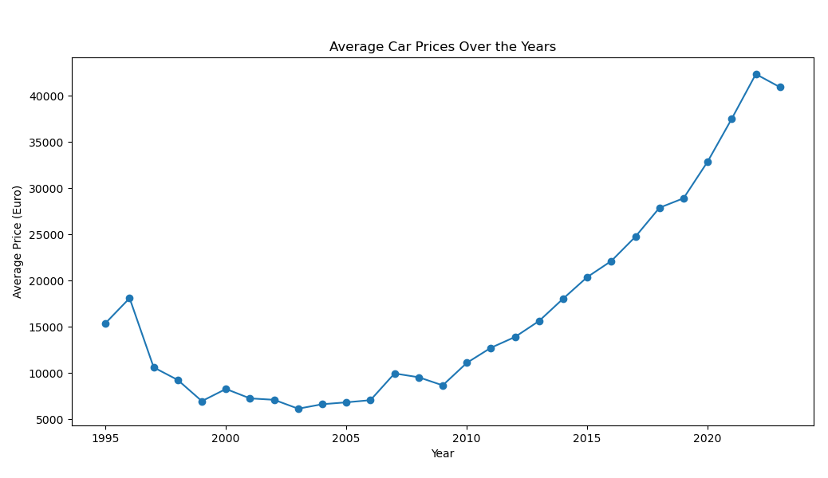
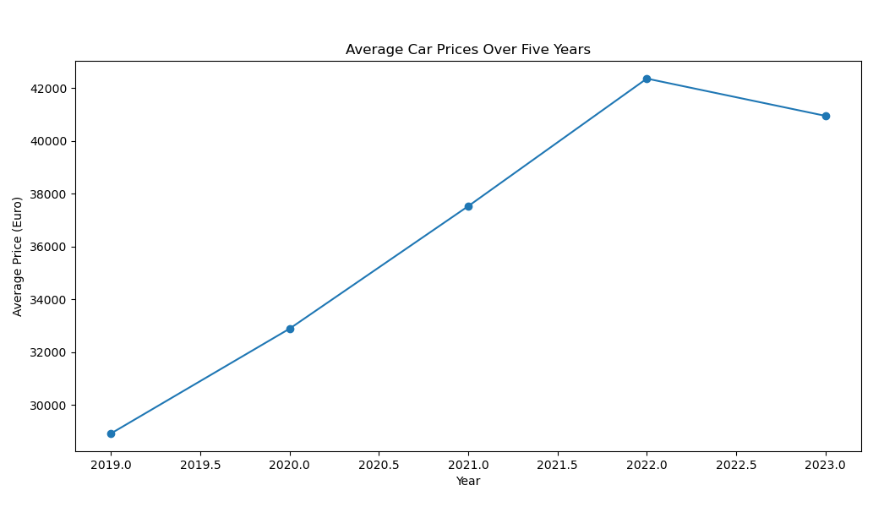
Question 1
How the Price and Sales of Used Car change from 1995 to 2023?
The price of Vehicle is increase from 1995 to 2023.
Prices of used cars have declined since 2022

Slide 6
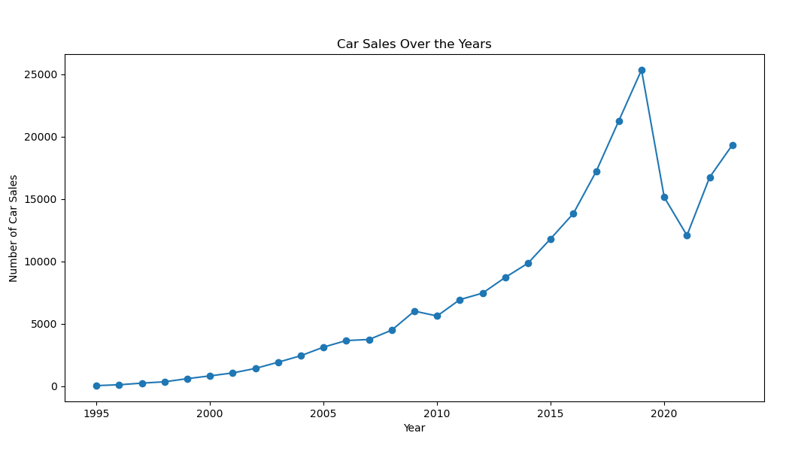
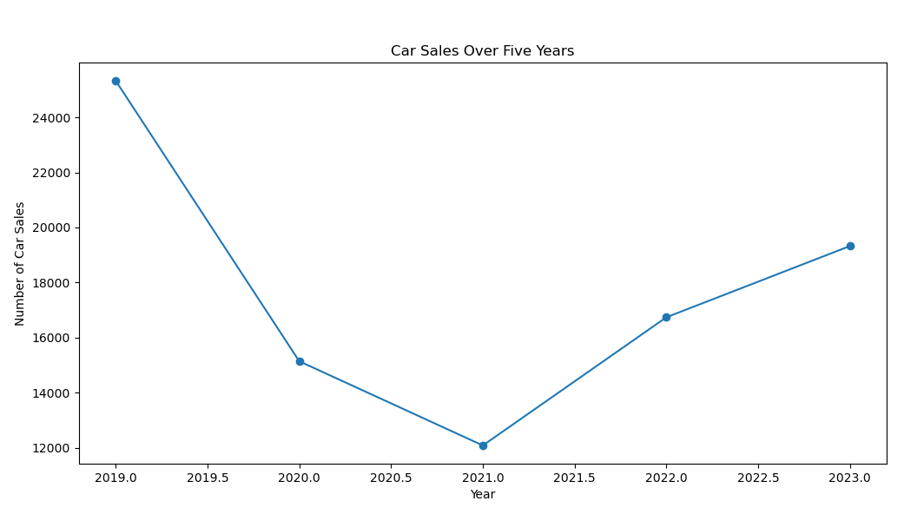
Question 1
How the Price and Sales of Used Car change from 1995 to 2023?
Used car market sales begin to fall sharply starting in 2019 and begin to rise in 2021
We decided to select mainly the last five years of data for more detailed analysis

Slide 7
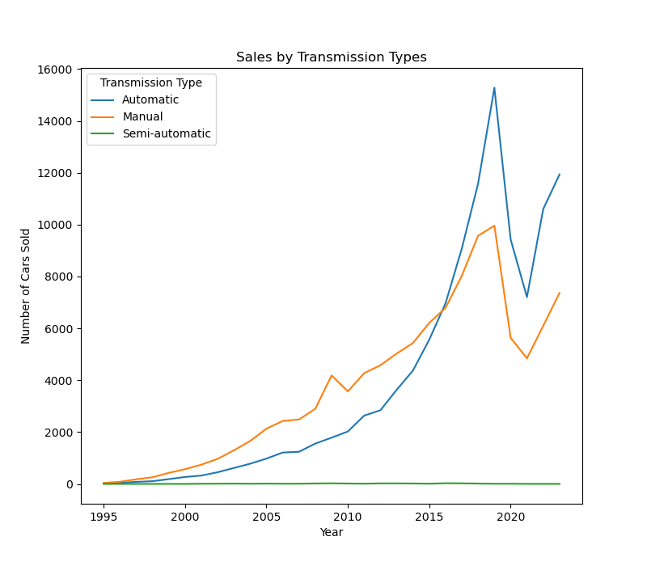
Question 2 - How many cars were sold annually in each transmission type?

Slide 8
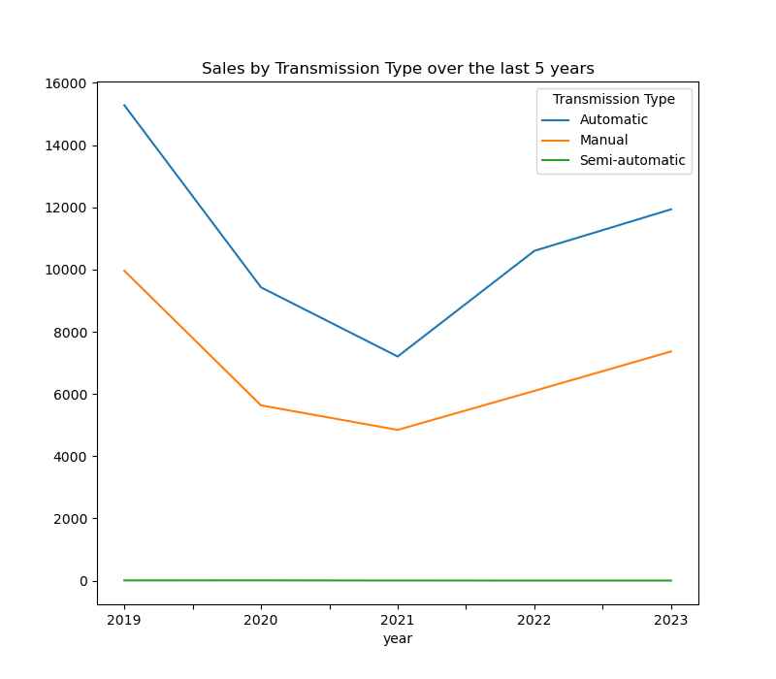
Question 2 - How many cars were sold annually in each transmission type?

Slide 9
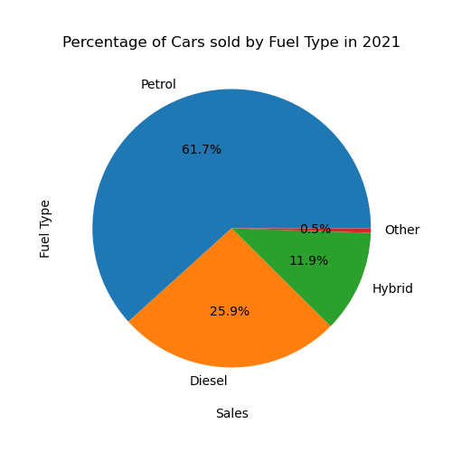
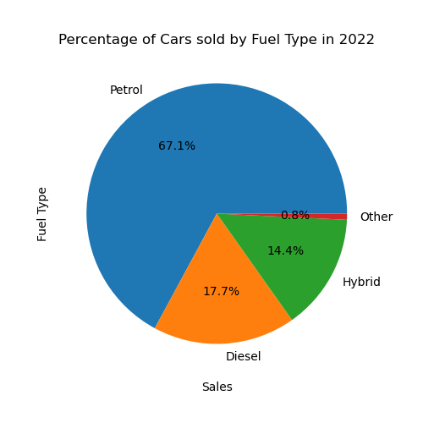
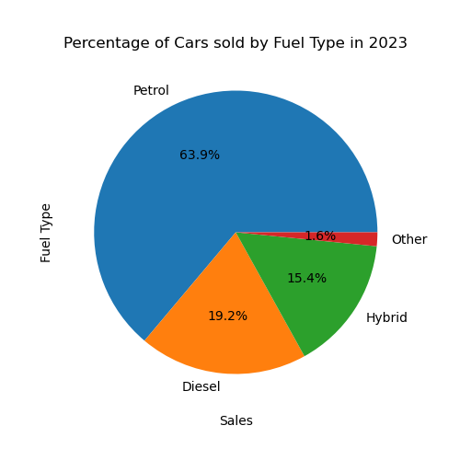
Question 3 - What Percentage of Cars sold were Hybrid during the last 3 years?
The % of Hybrid vehicles sold went up from 11.9% in 2020, to 15.4% in 2023 (an increase of over 30% in 3 years)

Slide 10
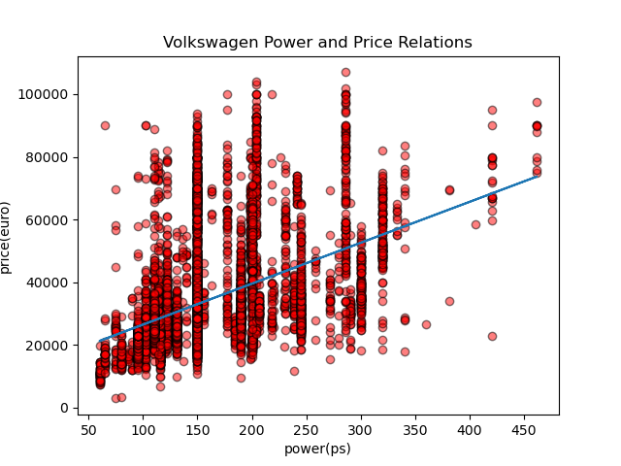
Question 4: The relation between power and price?
Correlation Coefficient:
0.45311782114879673

Slide 11
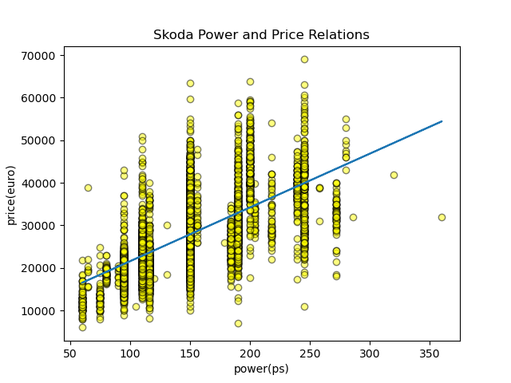
Question 4: The relation between power and price?
Correlation Coefficient:
0.6282053320158882

Slide 12
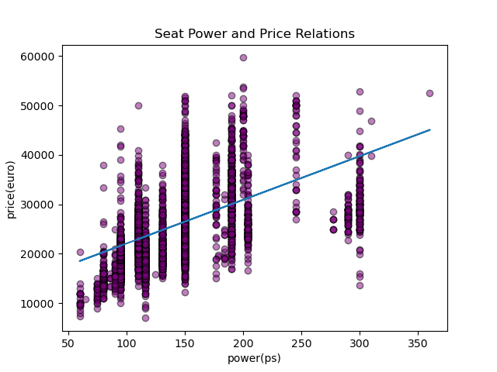
Question 4: The relation between power and price?
Correlation Coefficient:
0.5146972013415813

Slide 13
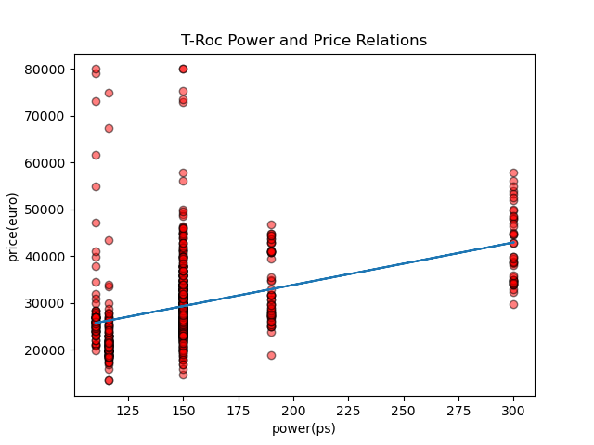
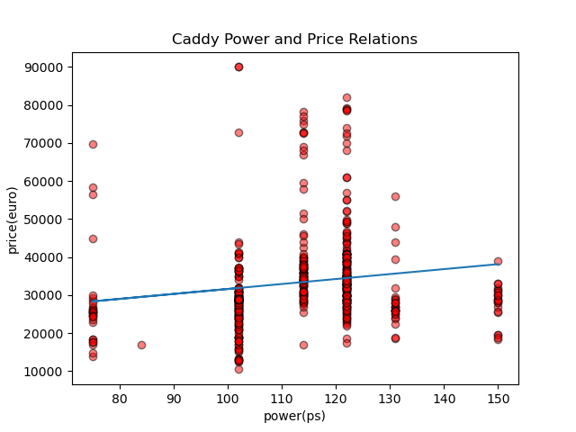
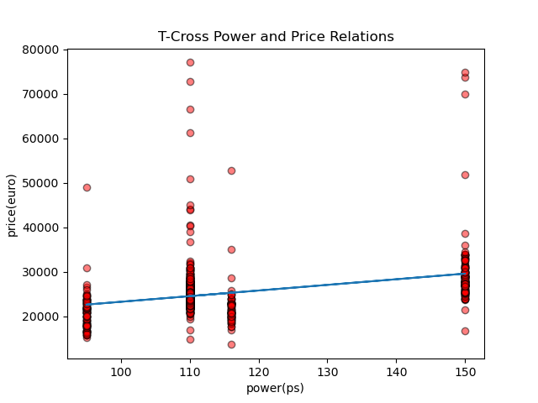
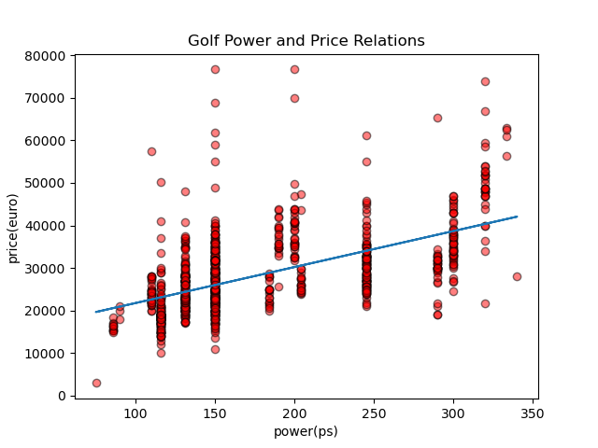
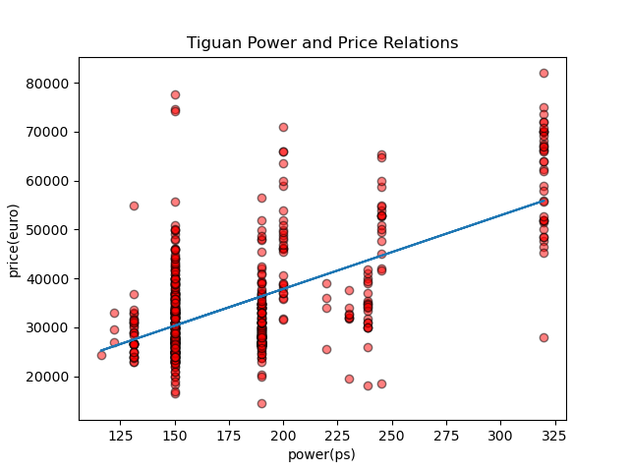
Question 4: The relation between power and price?

Slide 14
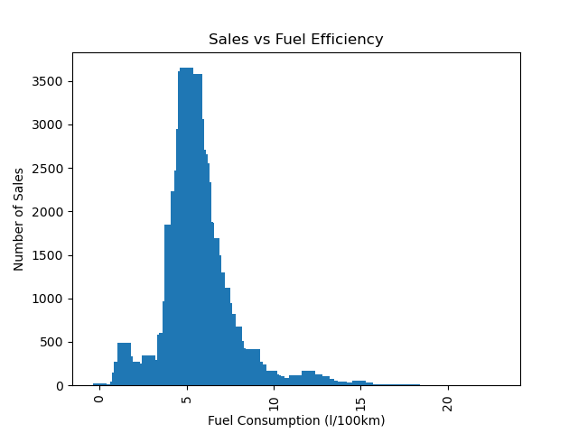
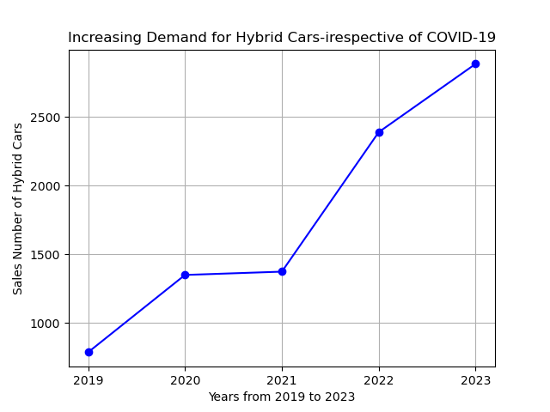
Question 5: Do Fuel efficiency affects Sales numbers and Is there a shift towards Hybrid cars

Slide 15
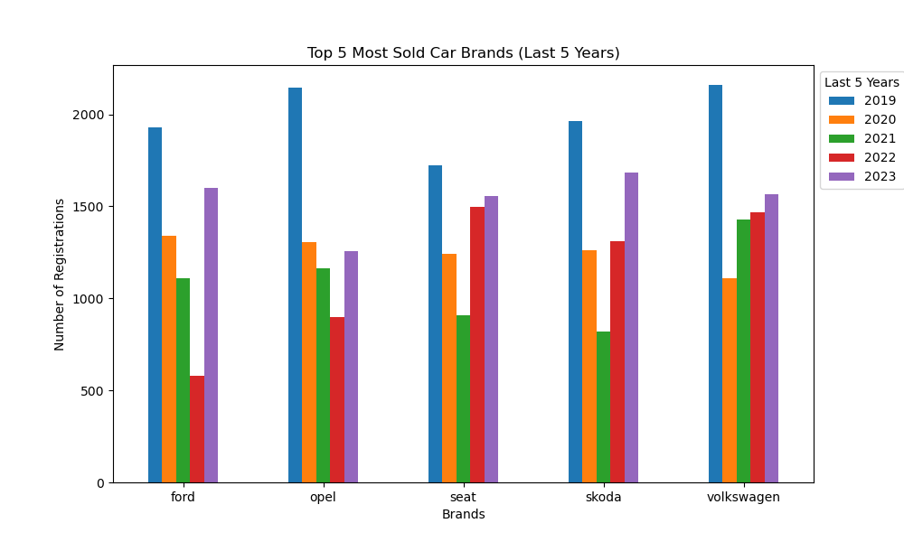
Top 5 Brands sold in Germany: Volkswagen 7731, Skoda 7044, Seat 6924, Opel 6773 and Ford 6557 units
Question 6: Which brand has the biggest Market share in Germany's Car market sales market in the last 5 years?
Identifying Top 5 Car Brands in Germany :
Stable Market for top Brands
2. Volkswagen's Market Share Stability
3. Resilience during Pandemic
4. Ford's presence in the German car market

Slide 16
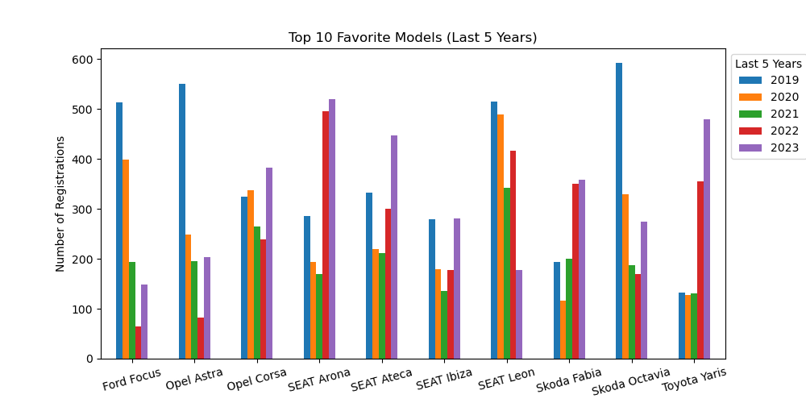
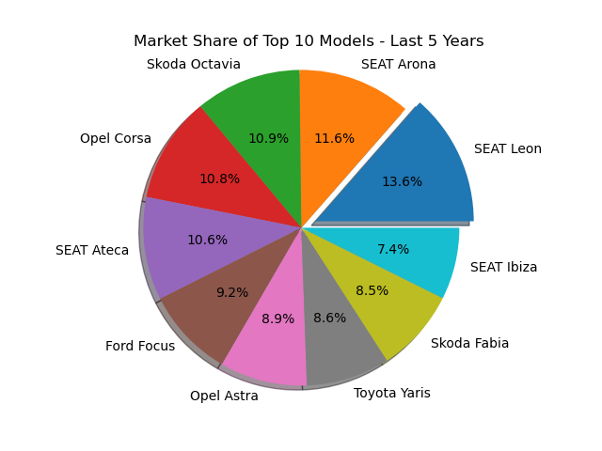
Question 6 - Top 10 favorite Car Models

Slide 17
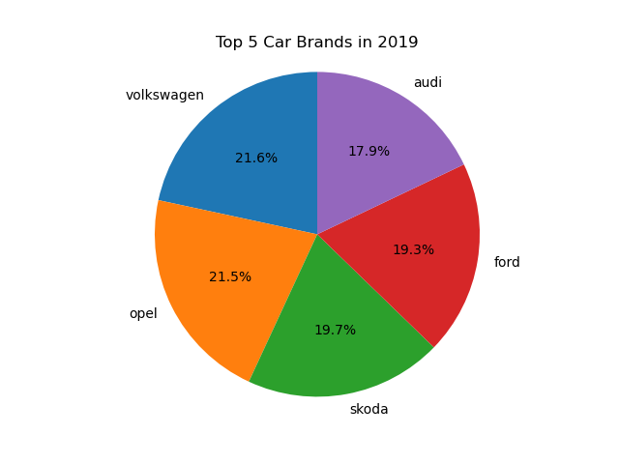
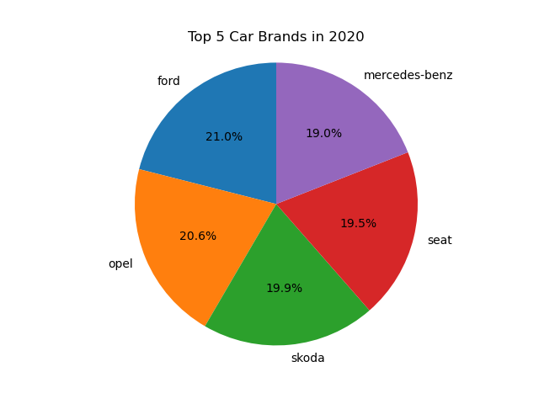
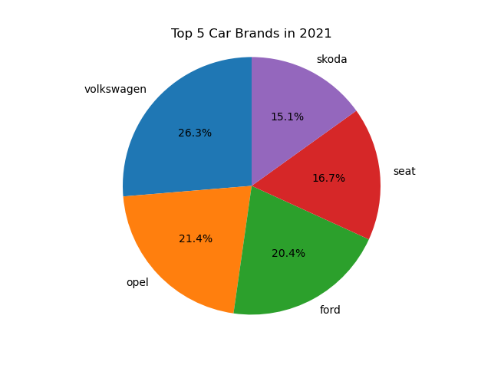
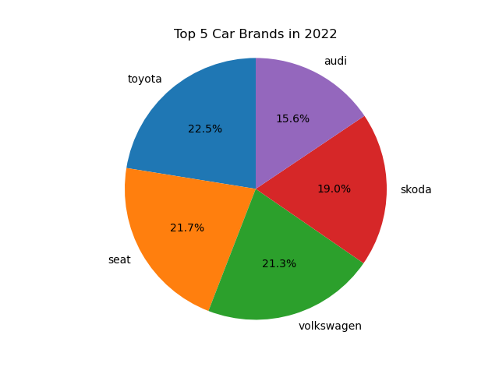
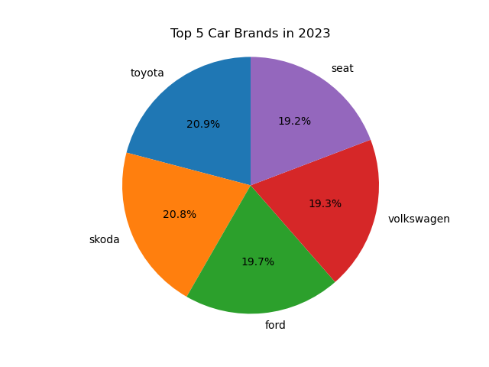
Market Share of Top 5 Brands - 5 years

Slide 18

Conclusion
Over 30 years, the price of the secondary vehicles have been trending upward； Used car sales also show an upward trend, but decline dramatic in 2019 and recover in 2021
While manual transmission vehicles were more preferred in the used-car market in Germany in the early 2000s, the preference has changed over the last 10 years. Since around 2016, there has been a steep increase in the number of Automatic vehicles sold.
The analysis of the last 3 years of data indicates an increasing preference for Hybrid vehicles in the used-car market. The % of Hybrid cars went up from 11.9% in 2021 to 15.4% in 2023 (over 30% increase in 3 years).
There is a positive relationship between Power and Price. As Power increases, price will also increase.
The highest sales figures are visible in the most efficient range of 4 l/100 km to 8 l/100 km
The top 5 Brands sold in Germany are Volkswagen 7731, Skoda 7044, Seat 6924, Opel 6773 and Ford 6557 units. And Skoda

Slide 19

Q & A

Slide 20
Thank you

